Slide 1


HEP NTUA Weekly Report 24/2/2021
George Bakas

Slide 2
Summary
ttX analysis:
Production of UL files
Production for 2018 again because files changed
2016 is missing bTagging WP’s and scale factors
Chain of analysis:
Contamination
Closure tests
Mass Fit
Signal Extraction
---------------------------
Unfolding
---------------------------
Systematics
---------------------------
Combination
Consistency checks with Giannis
Z’ analysis
While mJJ cut raises, Z’ signal “mimics” ttbar → Less sensitivity in angular distributions
Trying to find solution: (angular ratio etc)

Slide 3
Contamination plots (mTop)
2016_preVFP
2016_postVFP
2017
2018

Slide 4
Mass Fit with Results
2016_preVFP
Floating Parameter FinalValue +/- Error
-------------------- --------------------------
kMassResol 1.0152e+00 +/- 4.27e-02
kMassScale 9.8901e-01 +/- 3.23e-03
kQCD_2b 5.0274e-02 +/- 3.78e-02
nFitBkg_2b 1.1462e-04 +/- 1.37e+01
nFitQCD_2b 1.5480e+03 +/- 9.55e+01
nFitSig2b 2.6022e+03 +/- 1.01e+02
Signal strength: r = 0.702314 ± 0.0332752

Slide 5
Mass Fit with Results
2016_postVFP
Floating Parameter FinalValue +/- Error
-------------------- --------------------------
kMassResol 9.6000e-01 +/- 4.90e-02
kMassScale 9.7883e-01 +/- 3.47e-03
kQCD_2b 3.9566e-01 +/- 1.39e+00
nFitBkg_2b 5.1107e-03 +/- 6.08e+01
nFitQCD_2b 1.0983e+03 +/- 1.12e+02
nFitSig2b 1.9929e+03 +/- 1.02e+02
Signal strength: r = 0.640463 ± 0.0388384

Slide 6
Mass Fit with Results
2017
Floating Parameter FinalValue +/- Error
-------------------- --------------------------
kMassResol 1.0047e+00 +/- 2.92e-02
kMassScale 1.0254e+00 +/- 2.17e-03
kQCD_2b 4.8315e-02 +/- 2.41e-02
nFitBkg_2b 9.1608e-04 +/- 2.58e+01
nFitQCD_2b 3.2792e+03 +/- 1.46e+02
nFitSig2b 5.9564e+03 +/- 1.55e+02
Signal strength: r = 0.662214 ± 0.0206756

Slide 7
Mass Fit with Results
2018
Floating Parameter FinalValue +/- Error
-------------------- --------------------------
kMassResol 9.8311e-01 +/- 2.57e-02
kMassScale 9.9167e-01 +/- 1.85e-03
kQCD_2b 1.4152e-02 +/- 2.95e-03
nFitBkg_2b 3.2440e-04 +/- 3.15e+02
nFitQCD_2b 4.7403e+03 +/- 1.59e+02
nFitSig2b 7.6356e+03 +/- 1.68e+02
Signal strength: r = 0.673655 ± 0.0179039

Slide 8
BACKUP

Slide 9
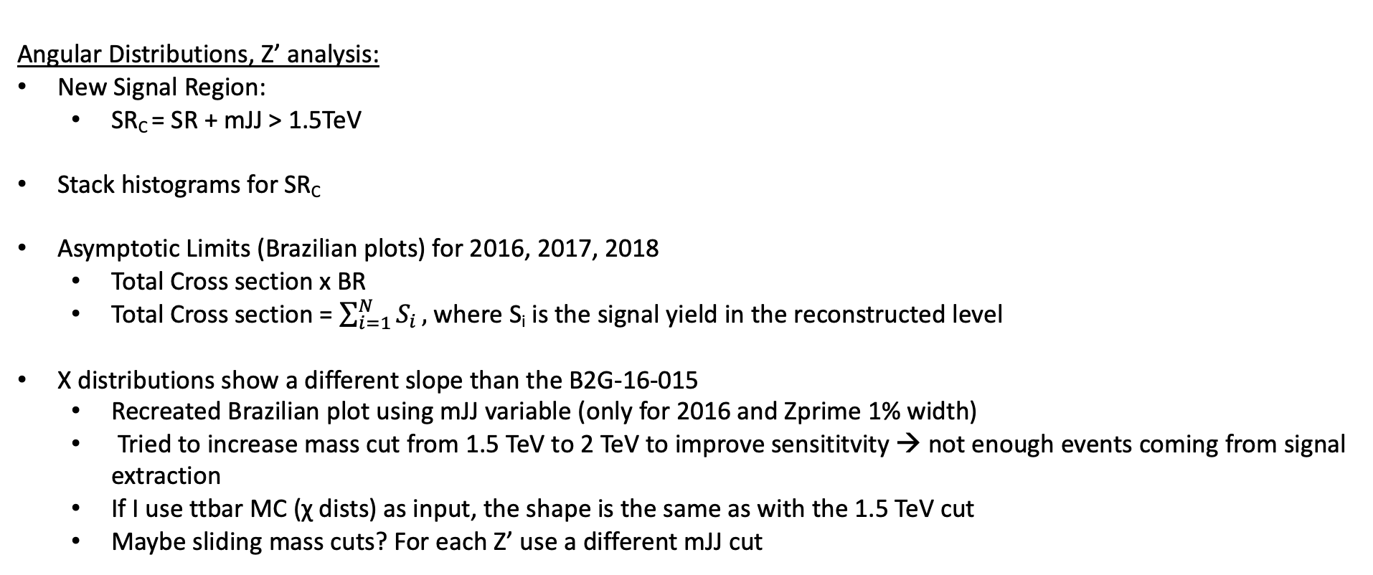
Summary
Angular Distributions, Z’ analysis:
New Signal Region:
SR_{C} = SR + mJJ > 1.5TeV
Stack histograms for SR_{C}
Asymptotic Limits (Brazilian plots) for 2016, 2017, 2018
Total Cross section x BR
Total Cross section = $\sum_{i=1}^{N}{S_{i}},$where S_{i} is the signal yield in the reconstructed level
Χ distributions show a different slope than the B2G-16-015
Recreated Brazilian plot using mJJ variable (only for 2016 and Zprime 1% width)
Tried to increase mass cut from 1.5 TeV to 2 TeV to improve sensititvity → not enough events coming from signal extraction
If I use ttbar MC (χ dists) as input, the shape is the same as with the 1.5 TeV cut
Maybe sliding mass cuts? For each Z’ use a different mJJ cut

Slide 10
Signal Selection
Control Region Selection
Variables | Selected Cut
pT (both leading jets) | > 400 GeV
Njets | > 1
N leptons | = 0
|eta| (both leading jets) | < 2.4
mJJ | > 1000 GeV
jetMassSoftDrop (only for fit) | (50,300) GeV
Top Tagger | > 0.2, 0, 0.1
B tagging (2 btagged jets) | > Medium WP
Signal Trigger
Variables | Selected Cut
pT (both leading jets) | > 400 GeV
Njets | > 1
N leptons | = 0
|eta| (both leading jets) | < 2.4
mJJ | > 1000 GeV
jetMassSoftDrop (only for fit) | (50,300) GeV
Top Tagger | > 0.2, 0, 0.1
B tagging (0 btagged jets) | < Medium WP
Control Trigger

Slide 11
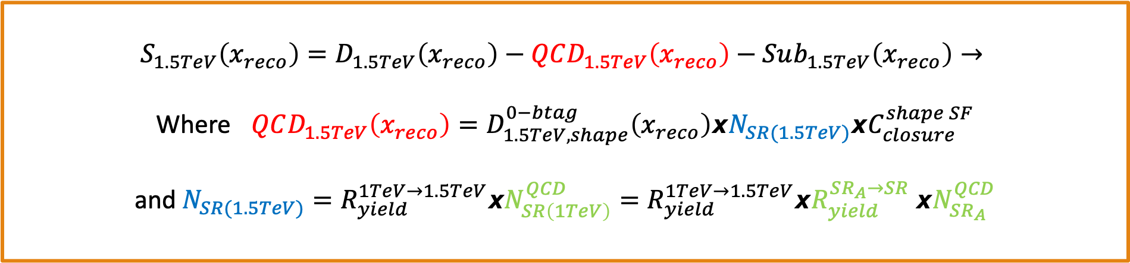
Signal Extraction
$$S_{1.5TeV}\left(x_{reco}\right)=D_{1.5TeV}\left(x_{reco}\right)−QCD_{1.5TeV}\left(x_{reco}\right)−Sub_{1.5TeV}\left(x_{reco}\right)→$$
Where $QCD_{1.5TeV}\left(x_{reco}\right)=D_{1.5TeV, shape}^{0−btag}\left(x_{reco}\right)xN_{SR(1.5TeV)}{xC}_{closure}^{shape SF}$
and $N_{SR(1.5TeV)}=R_{yield}^{1TeV→1.5TeV}xN_{SR\left(1TeV\right)}^{QCD}=R_{yield}^{1TeV→1.5TeV}xR_{yield}^{SR_{A}→SR} {xN}_{SR_{A}}^{QCD}$
The variable of interest here: x_{reco} → χ
1.5 TeV refers to the mJJ cut
We deploy a fit in the Signal Region (2btag) to extract the $N_{QCD}^{fit}$ in SRA (mJJ > 1TeV)
$$D{\left(m^{t}\right)}^{(i)}=N_{tt}^{(i)}T^{(i)}\left(m^{t},k_{MassScale}, k_{MassResolution}\right)+N_{bkg}^{(i)}B\left(m^{t} \right)\left(1+k_{1}x\right)+N_{sub}^{(i)}O^{(i)}\left(m^{t}\right)$$

Slide 12
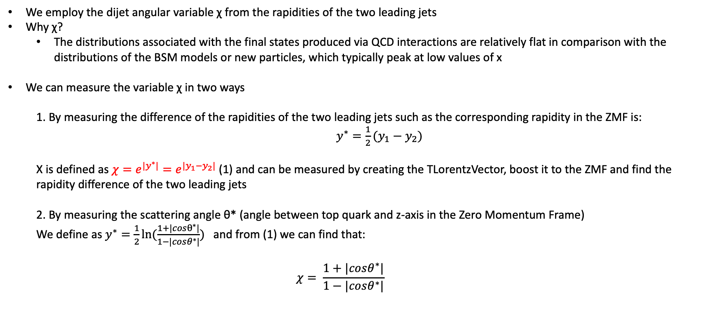
Top Angular Distributions
We employ the dijet angular variable χ from the rapidities of the two leading jets
Why χ?
The distributions associated with the final states produced via QCD interactions are relatively flat in comparison with the distributions of the BSM models or new particles, which typically peak at low values of x
We can measure the variable χ in two ways
1. By measuring the difference of the rapidities of the two leading jets such as the corresponding rapidity in the ZMF is: $y^{∗}=\frac{1}{2}(y_{1}−y_{2})$
Χ is defined as $χ=e^{{|y}^{∗}|}=e^{|y_{1}−y_{2}|}$ (1) and can be measured by creating the TLorentzVector, boost it to the ZMF and find the rapidity difference of the two leading jets
2. By measuring the scattering angle θ* (angle between top quark and z-axis in the Zero Momentum Frame)
We define as $y^{∗}=\frac{1}{2}ln⁡(\frac{1+|cosθ^{∗}|}{1−|cosθ^{∗}|})$ and from (1) we can find that:
$$χ= \frac{1+|cosθ^{∗}|}{1−|cosθ^{∗}|}$$

